Slide 1
CORRELATION
Presenated by:
awais shah

Slide 2
Correlation
When we are talking about relation between two data that is usually called Correlation.
That relationship may be between variables, classes, natural phenomena's etc.…
The relationship existing between two or more than two Quantitative variables is called Correlation.
When an increase or decrease of one varaible is associated with an increase or decrease of another, it is called correlation.

Slide 3
Types of Correlation
There are two types of Correlation
Positive correlation.
Negative correlation

Slide 4
Positive Correlation
When both variables move in the same direction means either both increase or decrease together.
Examples;
Hot weather and demand of ice.
Consuming more electricity and amout of bill.
Income savings.

Slide 5
Negative Correlation
When both variables moves in opposite directions.
If the value of one variable increases the another variable decreases.
Examples;
1) Price and demand of commodity.
2) Age of a car and its resale price.

Slide 6
Measurement of correlation
It is also called correlation coefficient
It is represented by small (r).
It ranges from (-1 to +1).
It can be measured by two methods.
Graphical Method.
Formula method.

Slide 7
Graphical method
Scatter diagram is used in this method.
Which gives information about the nature(increasing or decreasing), strength of correlation.
Degree | Positive | Negatiive
Perfect | +1 | -1
High | +0.75 | -0.75
Low | 0 to 0.25 | 0 to -0.25
zero | 0 | 0

Slide 8
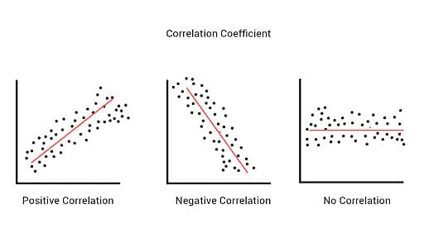
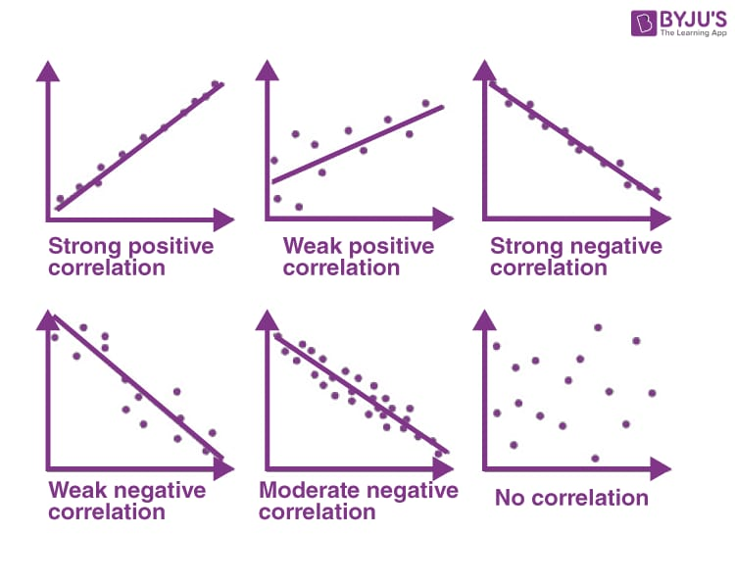
Graphical method

Slide 9
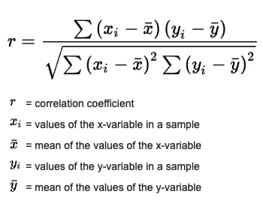
Formula method
Karl pearson’s Co-efficient of correlation is used in this method.
It’s the numerical method of nature, strength of the correlation.

Slide 10
Covariance
Covariance is a statistical measure that tells you how two variables change together. It indicates whether they tend to move in the same direction (positive covariance), opposite directions (negative covariance), or have no clear linear relationship (zero covariance).
Understanding Covariance:
Imagine you have data on the number of hours students study (X) and their corresponding exam scores (Y).
A positive covariance would suggest that as study hours increase (X increases), exam scores also tend to increase (Y increases). This indicates a positive relationship.
Conversely, a negative covariance would imply that as study hours increase (X increases), exam scores tend to decrease (Y decreases). This could be due to factors like burnout if students study for too long.
Zero covariance suggests no clear linear relationship between study hours and exam scores. There might be other factors influencing scores more significantly.

Slide 11
Calculating Covariance:
There are formulas to calculate covariance, but understanding the concept doesn't necessarily require memorizing them. Here's the general idea:
Number of hours students study (X) and their corresponding exam scores (Y).
Find the average of both variables (mean of study hours and mean of exam scores).
For each data point, calculate the difference between the actual value and the average for both variables (X - X_average and Y - Y_average).
Multiply these differences together for each data point.
Average the products obtained in step 3.
The resulting value is the covariance. A positive value indicates a positive relationship, a negative value suggests a negative relationship, and zero implies no clear linear trend.

Slide 12

How to Calculate Covariance
Suppose we have two variables:
Number of hours students study (X) and their corresponding exam scores (Y).
Here we have formula to calculate covariance
Cov(X, Y) = $\frac{\text{Σ} \text{[}\text{(}\text{Xi}\text{ -}\text{X}\text{̅} \text{) * (}\text{Yi}\text{ -Ȳ)}\text{]}}{n}$
Cov(X, Y): Covariance between X and Y
n: Total number of data points (number of students in your example)
Σ: Summation symbol (sum over all data points)
Xi: The value of X for the i-th data point (individual student's study hours)
X̅: Mean of X (average number of hours studied)
Yi: The value of Y for the i-th data point (individual student's exam score)
Ȳ: Mean of Y (average exam score)

Slide 13

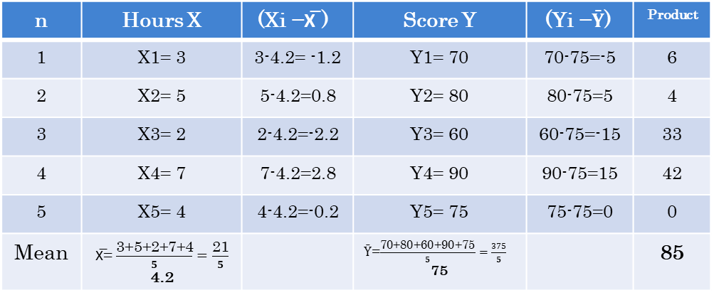
Example
n | Hours X | $$\text{(}\text{Xi} \text{−}\text{X}\text{̅} \text{) }$$ | Score Y | $$\text{(}\text{Yi} \text{−}\text{Ȳ)}$$ | Product
1 | X1= 3 | 3-4.2= -1.2 | Y1= 70 | 70-75=-5 | 6
2 | X2= 5 | 5-4.2=0.8 | Y2= 80 | 80-75=5 | 4
3 | X3= 2 | 2-4.2=-2.2 | Y3= 60 | 60-75=-15 | 33
4 | X4= 7 | 7-4.2=2.8 | Y4= 90 | 90-75=15 | 42
5 | X5= 4 | 4-4.2=-0.2 | Y5= 75 | 75-75=0 | 0
Mean | X̅= $\frac{\text{3}\text{+}\text{5}\text{+}\text{2}\text{+}\text{7}\text{+}\text{4}}{5}=\frac{\text{21}}{5}$ 4.2 |  | Ȳ=$\frac{\text{70}\text{+}\text{80}\text{+}\text{60}\text{+}\text{90}\text{+}\text{75}}{5}=\frac{375}{5}$ 75 |  | 85
Suppose we have two variables:
Hours students study (X)= 3, 5, 2, 7, 4
Exam scores (Y)= 70, 80, 60, 90, 75
To find covariance between them we have formula below
Cov(X, Y) = $\frac{\text{Σ} \text{[}\text{(}\text{Xi} \text{−}\text{X}\text{̅} \text{) }\text{∗ }\text{(}\text{Yi} \text{−}\text{Ȳ)}\text{]}}{n−1}$ by Splitting formula
Cov(X, Y) = $\frac{\text{[}\text{(}\text{X}\text{1} \text{−}\text{X}\text{̅} \text{)}\text{(}\text{Y}\text{1} \text{−}\text{Ȳ)}\text{+}\text{(}\text{X}\text{2} \text{−}\text{X}\text{̅} \text{)(}\text{Y}\text{2} \text{−}\text{Ȳ)}\text{+}\text{(}\text{X}\text{3} \text{−}\text{X}\text{̅} \text{)(}\text{Y}\text{3} \text{−}\text{Ȳ)}\text{+}\text{(}\text{X}\text{4} \text{−}\text{X}\text{̅} \text{)(}\text{Y}\text{4} \text{−}\text{Ȳ)}\text{+}\text{(}\text{X}\text{5} \text{−}\text{X}\text{̅} \text{)(}\text{Y}\text{5} \text{−}\text{Ȳ)}\text{]}}{n−1}$
Here
n: 5
Xi: 3,5,2,7,4
X̅: 4.2
Yi: 70,80,60,90,75
Ȳ: 75
Cov(X, Y) = $\frac{\text{85}}{5−1}$ = $\frac{\text{85}}{4}$ ₌ 21.25
So covariance of X & Y is 21.25 which is positive value which mean as study hours increase exam score also increase.

Slide 14
That’s All About Correlation

